Slide 1
Experience the
Enchanting World of
Geographical Indications (GIs) of India

Slide 2
GIs identify goods as originating or manufactured in a region where a given quality, reputation or other sets of characteristics is essentially attributable to its origin.
Every GI carries a name or tag that conveys an assurance of quality and distinctiveness.
The Geographical Indications of Goods (Registration and Protection) Act, 1999 envisages the registration and protection of GIs relating to goods originating in India.
GIs apply to agricultural, natural, or manufactured products (such as handicrafts and industrial goods) originating from a specific geographic location.
GEOGRAPHICAL INDICATIONS

Slide 3
BENEFITS OF GI REGISTRATION
Geographical Indications certify the quality and distinctiveness of a product and authenticate its geographical origin.
Promotes economic prosperity of producers in a region
Any association of persons/ producers/organisation/ authority can apply
Valid for 10 years with further option of renewal for 10 years
Producers can apply for registration as an authorized user of the registered GI
Protects against unauthorized use of a GI
Gives authorized users the right to sue for infringement

Slide 4
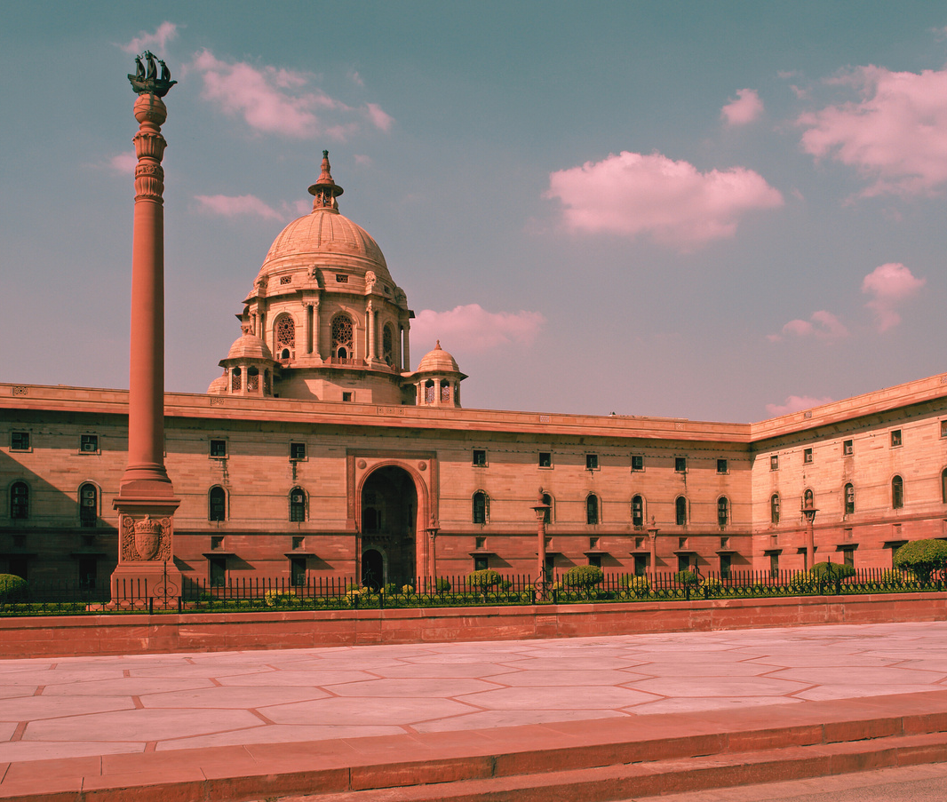
Initiatives to protect, preserve and commercialize the various art forms, products, and indigenous goods with exceptional qualities.
Operational Guidelines by the Department for Promotion of Industry and Internal Trade (DPIIT) to help identify potential GIs.
POLICY SUPPORT BY THE INDIAN GOVERNMENT
Financial Assistance for the promotion of GI tagged products to eligible agencies.
Permission to retail outlets and e-commerce platforms to use GI logo and tagline with prior approval.

Slide 5
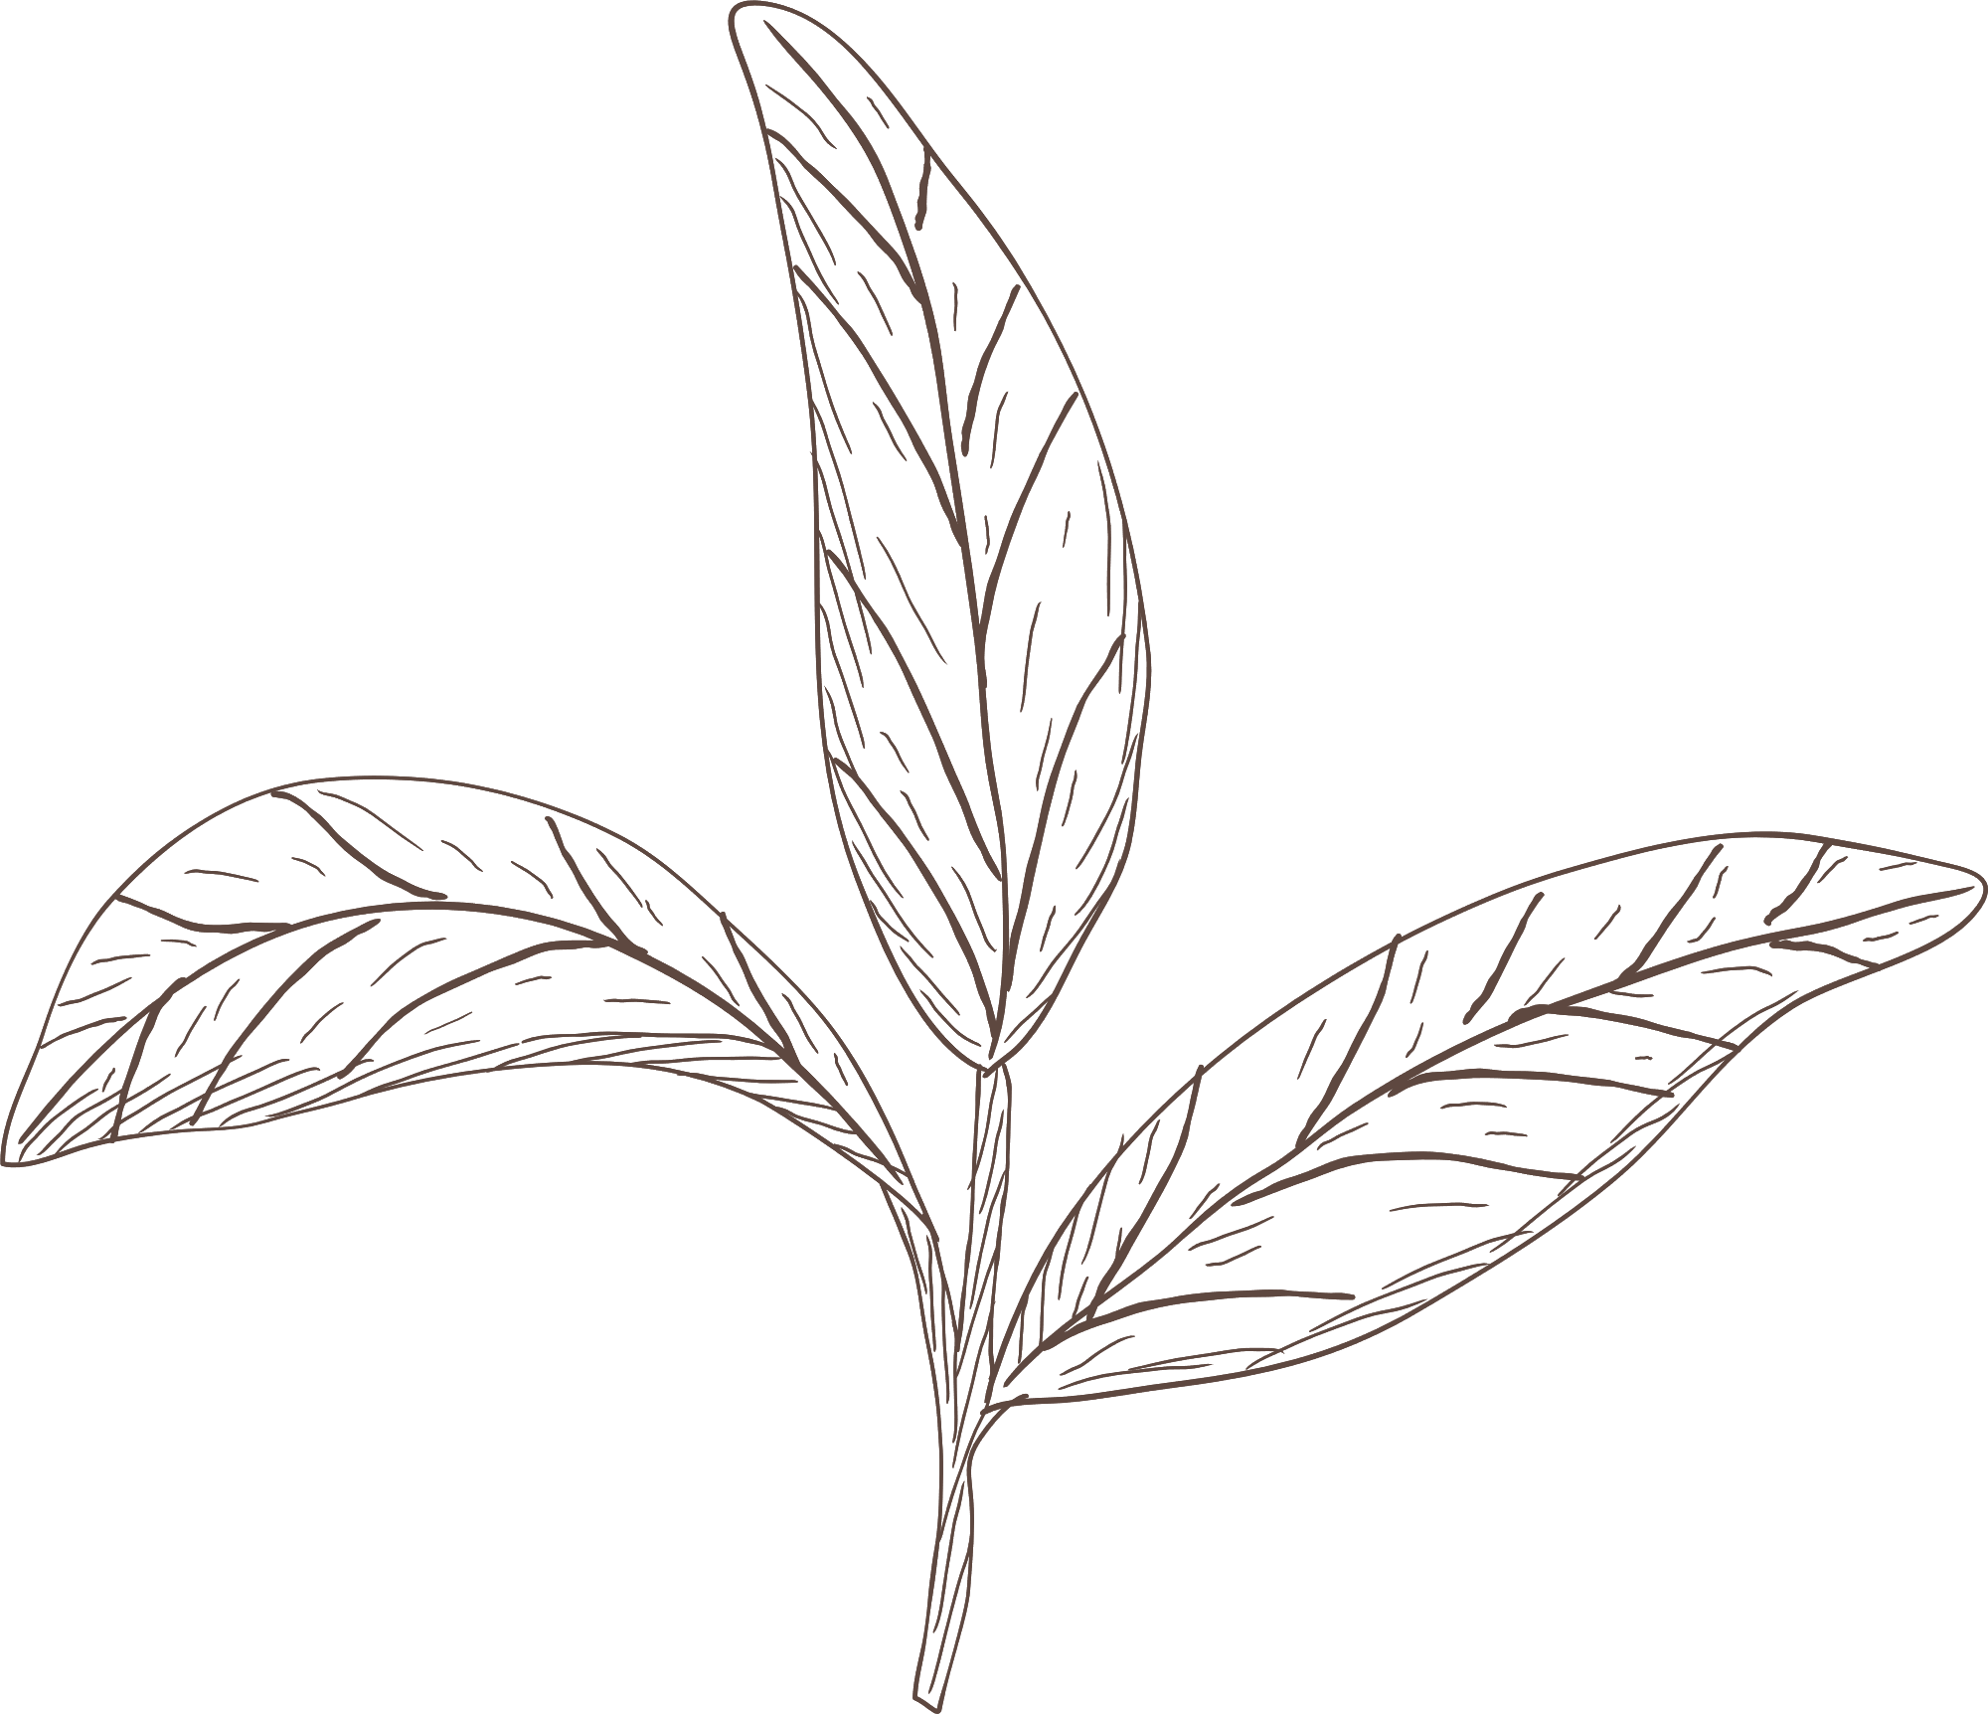
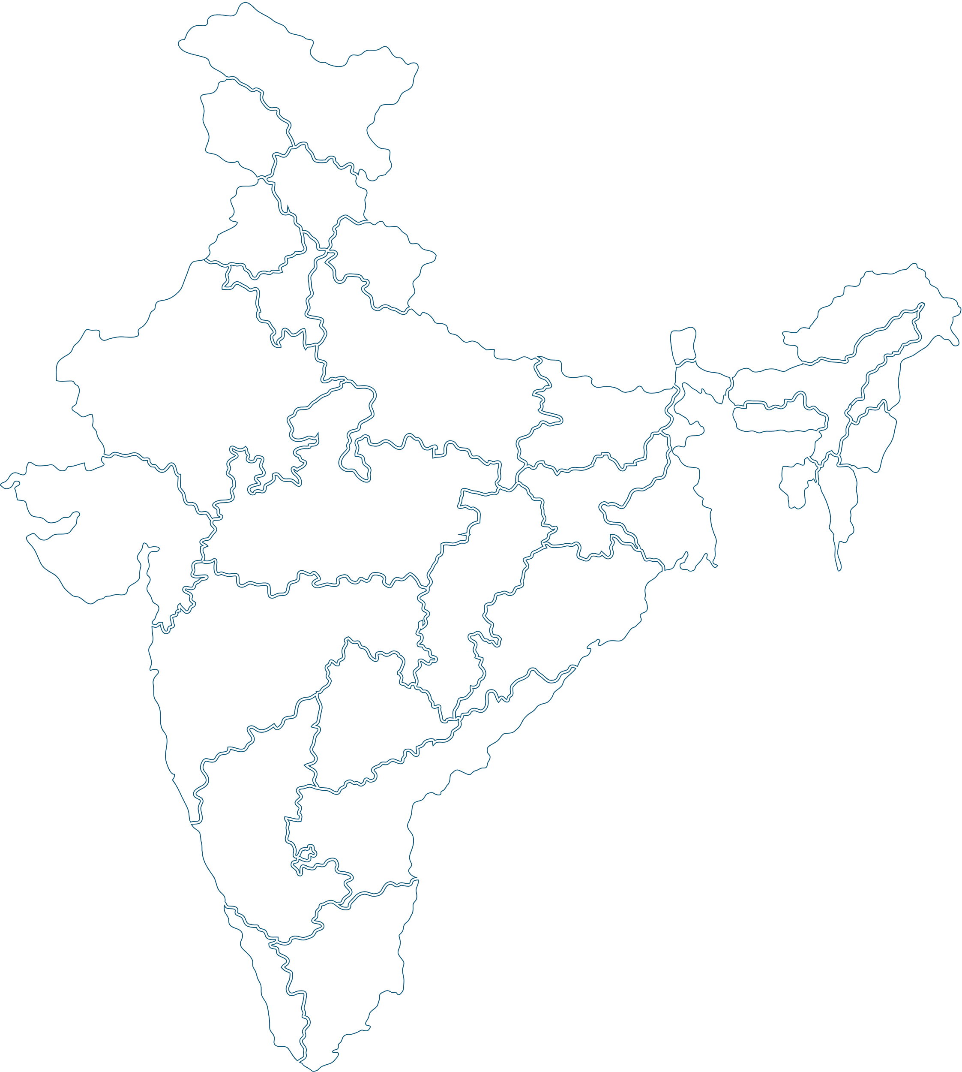
Darjeeling Tea was the first Indian product to get a GI tag in 2004
SOME INTERESTING FACTS
Tamil Nadu, Karnataka, Kerala, Uttar Pradesh, and Maharashtra hold most GIs
As of March 2023, the total number of GI Tags of India are 465

Slide 6
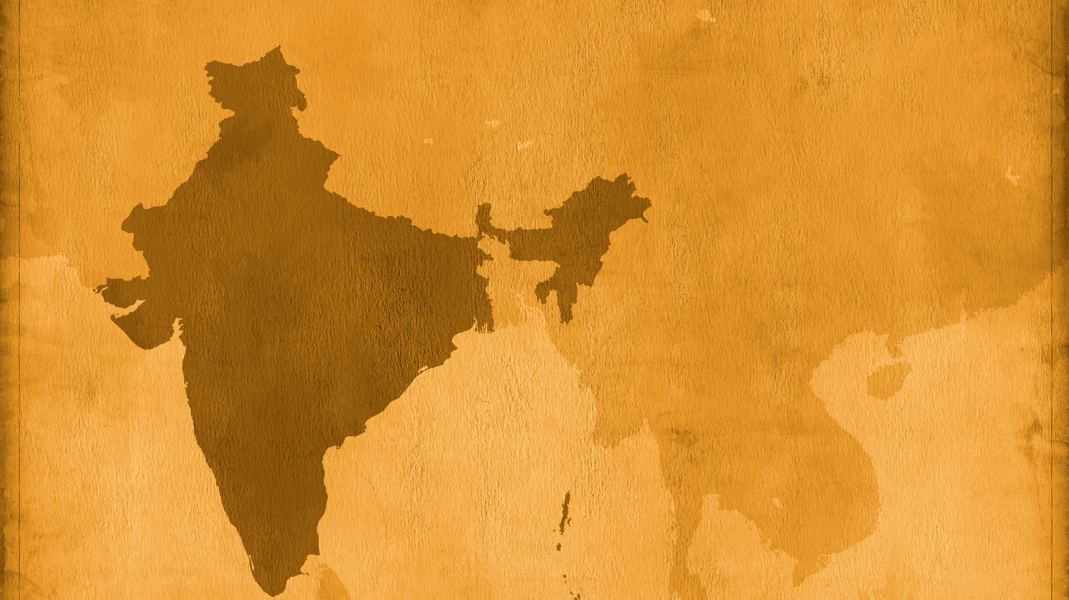
FAMOUS GIs IN INDIA

Slide 7
Madhubani Paintings from Bihar:
Intricate geometrical patterns created with fingers, twigs, brushes, nib pens, and matchsticks, using natural dyes and pigments.

Slide 8
Bastar Dhokra of Chhattisgarh:
A craft form of the erstwhile Harappa & Mohenjodaro Civilization that involves 16 intricate steps without using any mould.

Slide 9
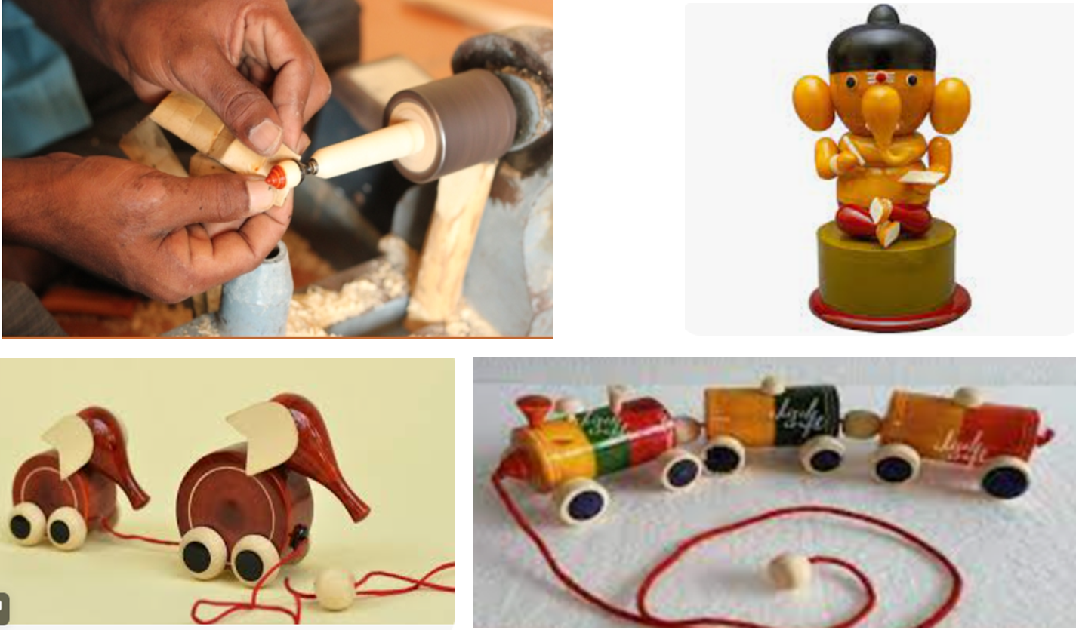
Etikoppaka Toys of Andhra Pradesh:
Crafted in the Etikoppaka region, these unique toys are made of wood and lacquer.

Slide 10
Papier-Mâché of Kashmir:
Made with paper pulp, it is a richly decorated, colourful artefact in the form of vases, bowls, cups, boxes, trays, or bases of lamps.

Slide 11
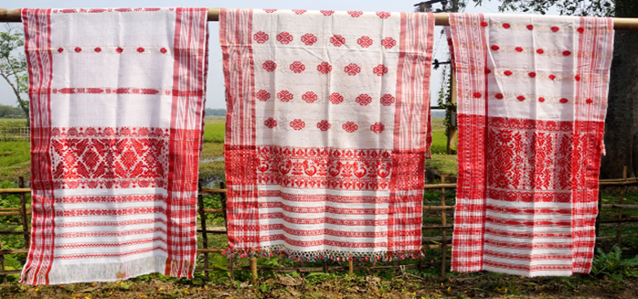
Gamccha of Assam:
Gamosa (or Gamocha), is a significant cultural symbol and identity of Assam, which is a white rectangular piece of cloth with a red border on three sides and red woven motifs on the fourth.

Slide 12
Gulabi Meenakari of Varanasi:
Meena is derived from "mina" i.e., heaven and "kari" i.e., to create. Meenakari is used to make exquisite pieces of jewelry and home décor items.

Slide 13
Channapatna Toys of Karnataka:
Channapatna toys, protected under the World Trade Organization, are a particular form of wooden toys (and dolls) manufactured in the town of Channapatna in the Ramanagara district.

Slide 14
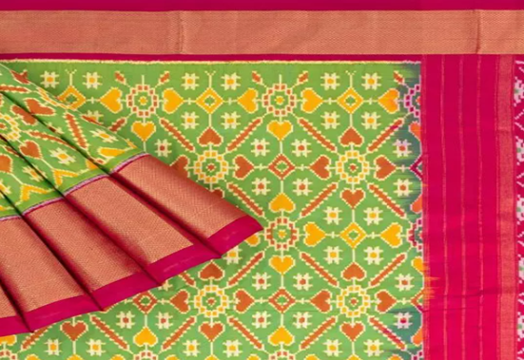
Pochampally IKAT of Telangana:
Pochampally sari or Pochampalli ikat is a saree with traditional geometric patterns in the "Paagadu Bandhu" (Ikat) style of dyeing with intricate geometric designs.

Slide 15
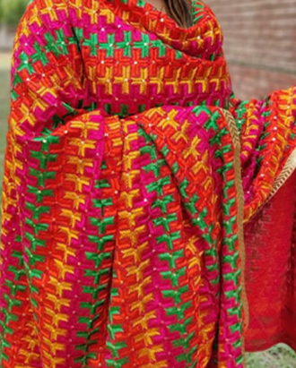
Phulkari of Punjab:
"Phulkari" i.e., "flower work" or "flower embroidery" is traditional embroidery work that originated in Punjab in the early 15th century.

Slide 16
Pashmina of Kashmir:
Handcrafted from the finest Ladakhi Cashmere with a fibre count of 12 to 16 microns, this wool is handspun by local women and involves complex handweaving.

Slide 17
Banaras Brocades and Sarees:
Made with finely woven silk and decorated with unique designs using zari, this ornamentation involves Mughal-inspired designs/elements such as intricate floral and foliate motifs.

Slide 18
Gorakhpur Terracotta:
This terracotta work is a traditional art form in which potters make figurines with hand-applied ornamentation.

Slide 19
CONTACT
For more information, please contact us through email/phone or visit our website.
mail@lexorbis.com
www.lexorbis.com
New Delhi | Mumbai | Bengaluru | Chennai

